Slide 1

D.MERIT JESLIN
FINAL PROJECT
FACE IMAGE GENERATION

Slide 2
Project title
FACE IMAGE GENERATION
DEGREE : BE COMPUTER SCIENCE AND ENGINEERING
NM ID : au950021104027
MAIL ID : meritjeslin@gmail.com
COLLEGE NAME : ANNA UNIVERSITY REGIONAL CAMPUS-TIRUNELVELI

Slide 3
Outline:
Problem Statement
Project Overview
End Users
Solution And Its Value Proportion
Uniqueness In Solution
Modelling
Result

Slide 4
Problem statement:
The problem statement for face image generation involves creating realistic and diverse images of human faces using artificial intelligence, typically through generative adversarial networks (GANs) or variational autoencoders (VAEs). The goal is to produce high-quality, diverse, and natural-looking images that can be used in various applications such as avatar creation, virtual reality, and facial recognition systems.

Slide 5
PROJECT OVERVIEW
Implementing StyleGAN architecture.
Training the model on a dataset of human faces.
Exploring techniques for latent space manipulation to generate diverse facial images.
Evaluating the quality and realism of generated images using appropriate metrics.
Possibly extending the model for specific applications like face aging, expression manipulation, etc.

Slide 6
End users
Researchers in Computer Vision and Machine Learning
AI Developers and Engineers
Content Creators and Designers
Game Developers
Entertainment Industry
Marketing and Advertising Agencies
Education and Training
Healthcare and Psychology Researchers
Privacy and Security Experts

Slide 7
Solution and its proposed value
Using StyleGAN for face image generation involves leveraging its ability to learn and control the high-level features of images, such as pose, expression, and identity, while generating high-resolution, realistic images. The proposed solution would entail training a StyleGAN model on a large dataset of face images to learn the underlying distribution of human faces. This trained model can then generate new face images by sampling from the learned distribution, allowing for the creation of diverse and high-quality face images with controllable attributes. Additionally, fine-tuning the model on specific datasets or tasks can further improve the quality and diversity of generated images.

Slide 8
Uniqueness in solution
Realism: Advanced generative models like StyleGAN create highly realistic faces with detailed features, enhancing applications in entertainment and digital art.
Controllable Attributes: StyleGAN allows precise manipulation of various facial attributes like age, gender, and expressions, offering unprecedented control over generated content.
Diversity: These models produce an infinite variety of faces, enabling the creation of unique characters and avatars for gaming, marketing, and storytelling.
Privacy Preservation: Face generation without relying on real-world data offers a privacy-preserving solution for tasks like face anonymization and synthetic data generation.
Artistic Exploration: Artists and designers use StyleGAN to explore new aesthetics and styles, pushing the boundaries of digital art and design.

Slide 9
modelling:
1. Data Collection and Preprocessing: Gather and prepare a diverse dataset of human faces.
2. Model Selection: Choose a suitable generative model architecture like StyleGAN or ProGAN.
3. Training Process: Train the selected model on the dataset using powerful hardware resources.
4. Latent Space Exploration: Explore the model's latent space to manipulate facial attributes.
5. Evaluation Metrics: Assess the quality and realism of generated faces using metrics like Inception Score and FID.
6. Fine-Tuning and Optimization: Refine the model through fine-tuning and optimization techniques.
7. Application Development: Develop applications for character generation, face editing, or data augmentation.
8. Continuous Improvement: Iterate on the model and applications based on user feedback and advancements in the field.

Slide 10
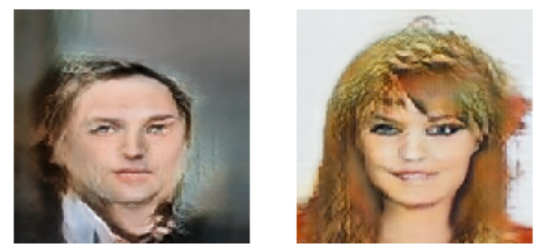
Result:

Slide 11
Thank you

